Slide 1
University of Pittsburgh Library System (ULS)
Faculty Senate Library Committee Meeting
October 4, 2018
Kornelia Tancheva

Slide 2
Libraries Within the ULS
Hillman
Fine Arts
Music
Center for American Music
Engineering
Chemistry
Langley
Regional campuses
Titusville
Johnstown
Bradford
Greensburg

Slide 3
ULS in numbers (FY’17)
Collections
6,585,808 volumes (includes e-books, e-journals)
Print book titles 4,836,017 (titles)
E-books 1,305,441
Print serials: 109,160
E-journals: 228,331
Databases: 571
Use of Collections
Physical circulation: 81,654 (50% decrease)
Full text article downloads: 5,585,713 (decrease)
Database searches: 4,834,860 (increase)

Slide 4
More Numbers
Visitors
1,907,512
Services
Reference 18,882 (50% decrease)
Instruction sessions: 994 (increase)
Number of participants in instruction sessions: 20,710 (increase)
ILL Borrowing: 39,197

Slide 5
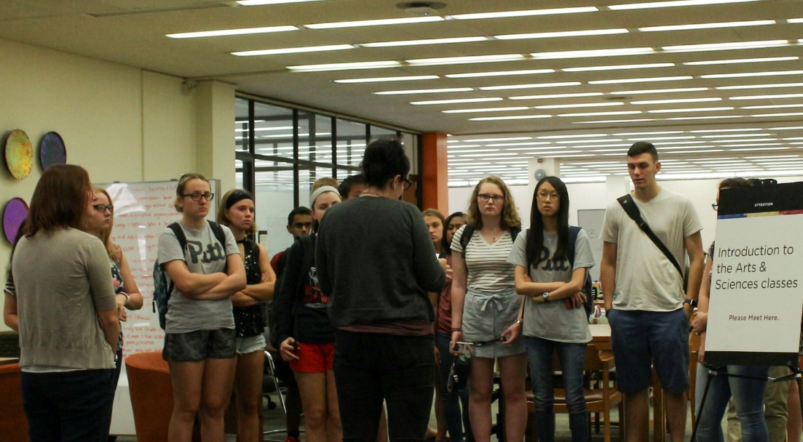
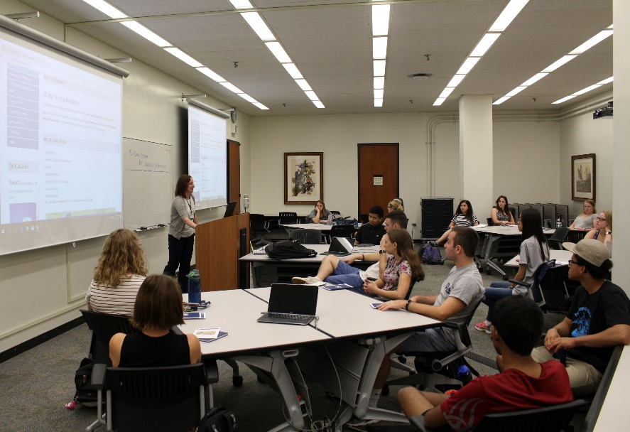
Services Highlights: Undergraduates
Introduction to the Arts and Sciences (FP0001)
pre-class tutorial

Slide 6
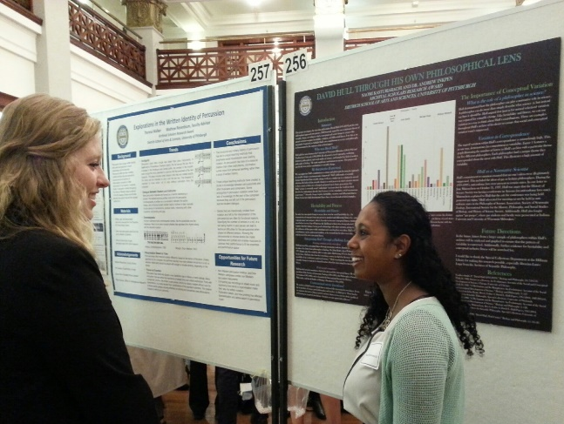
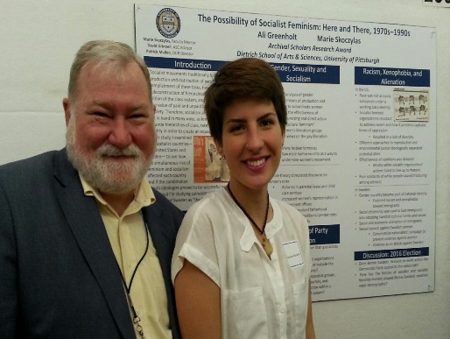
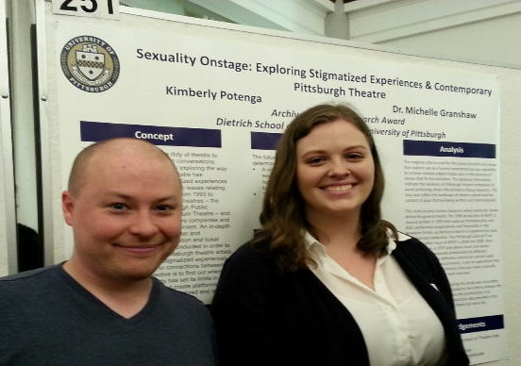
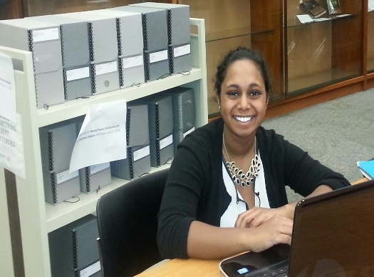
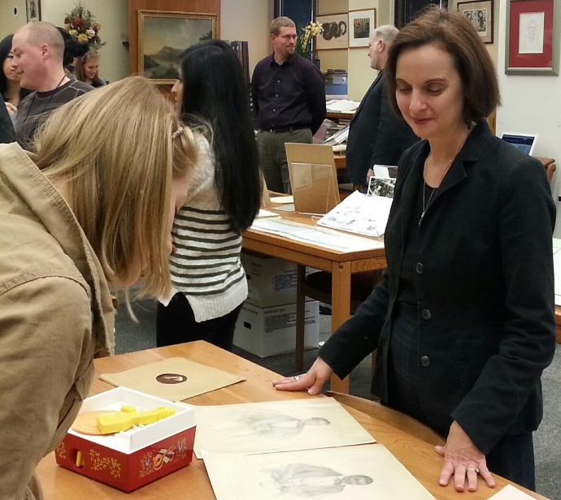
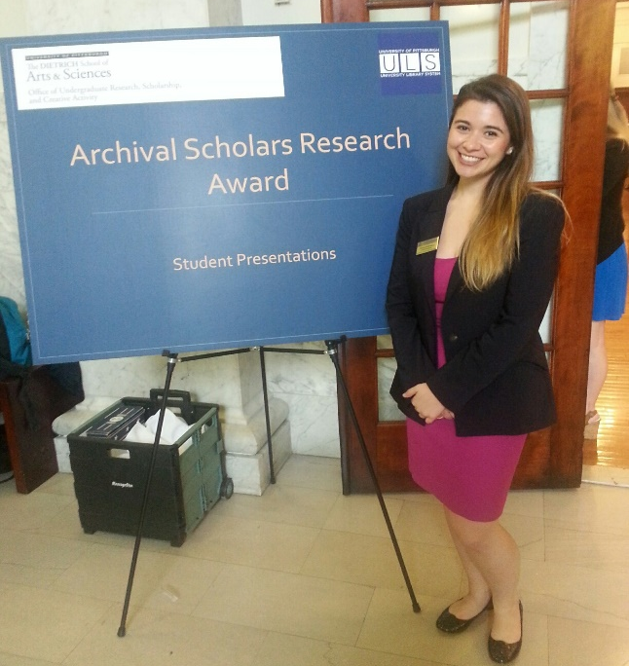
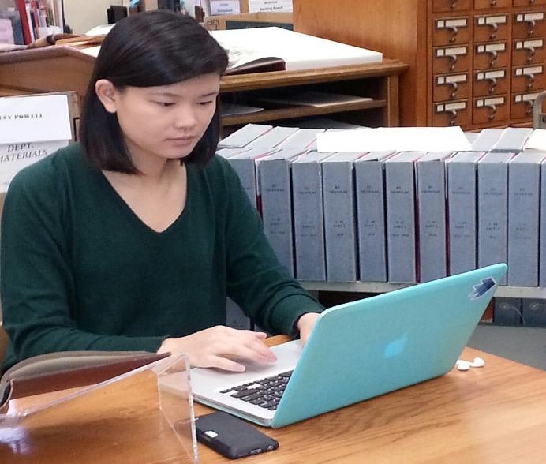
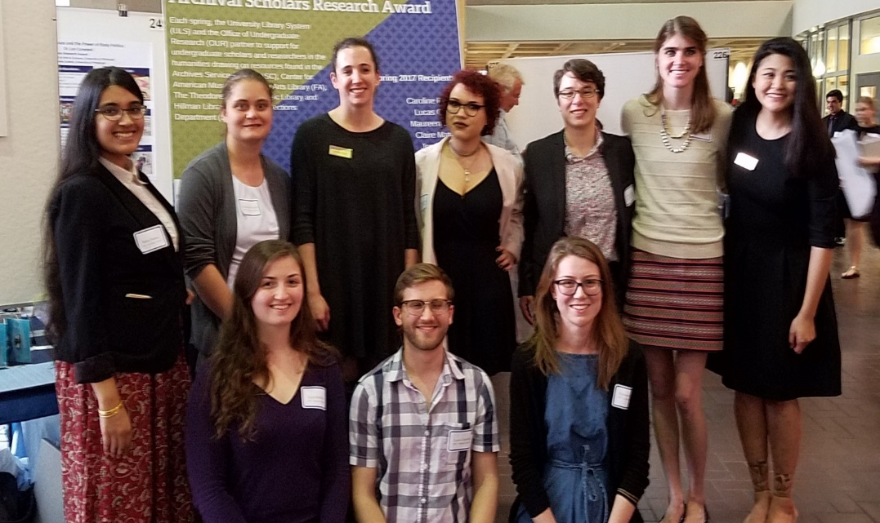
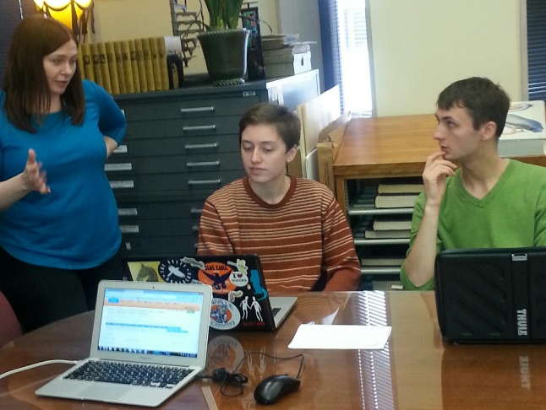
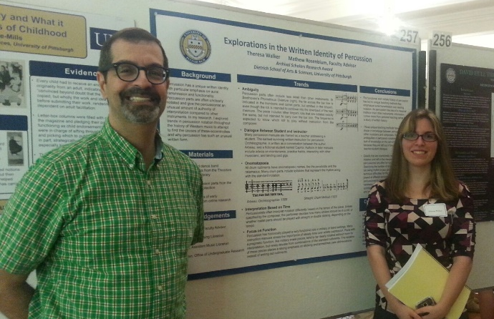
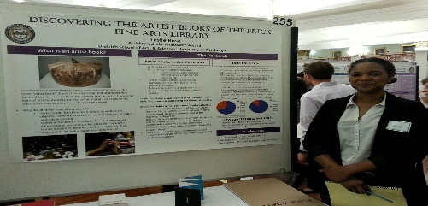
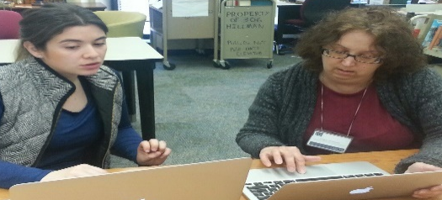

Slide 7
Services Highlights: All Users
Liaison program
“Your Librarian”
Personalized Service
Collaborate with functional experts
GIS
Digital Scholarship
Data Management
Metadata
Bibliometrics
Copyright
Scholarly Communication
Referrals

Slide 8
Services Highlights: Research (Faculty, Graduate Students, Undergrads)
Data Management
Planning, describing and documenting, organization, naming, formats, sharing
Data Management Committee
Digital Scholarship
Acquisition and management of digital information; digital tools and methods for content exploration, visualization, and analysis; digital-platform sharing
Consultations and partnerships; training and events; specialized spaces and labs; on- and off-campus coordination
ORCID
https://orcid.pitt.edu
Metadata
Bibliometrics
LibGuide

Slide 9
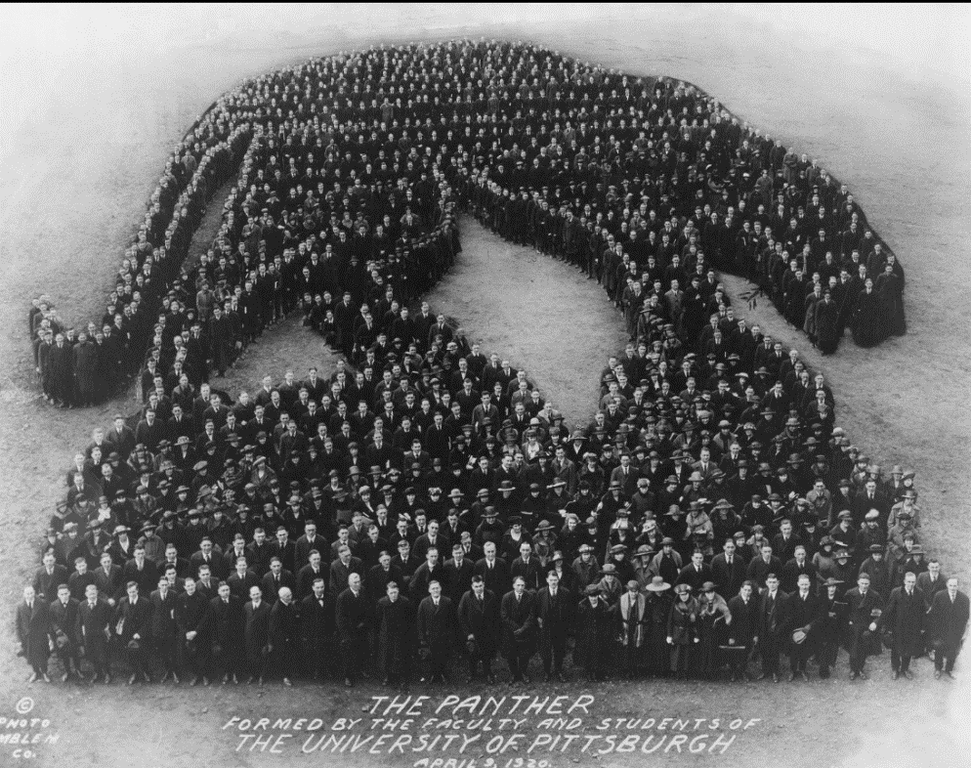
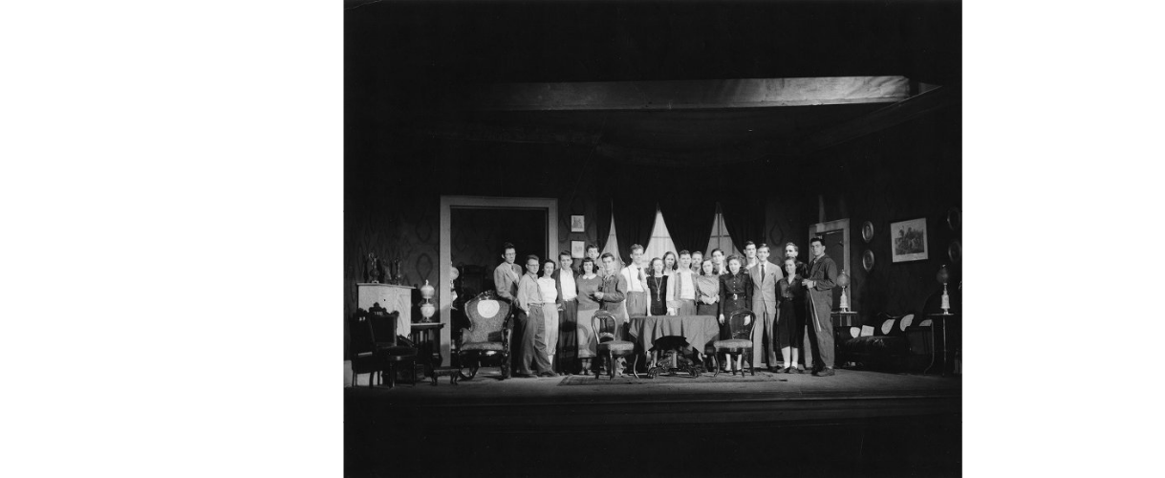
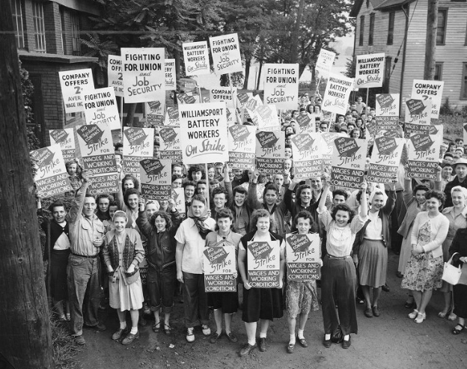
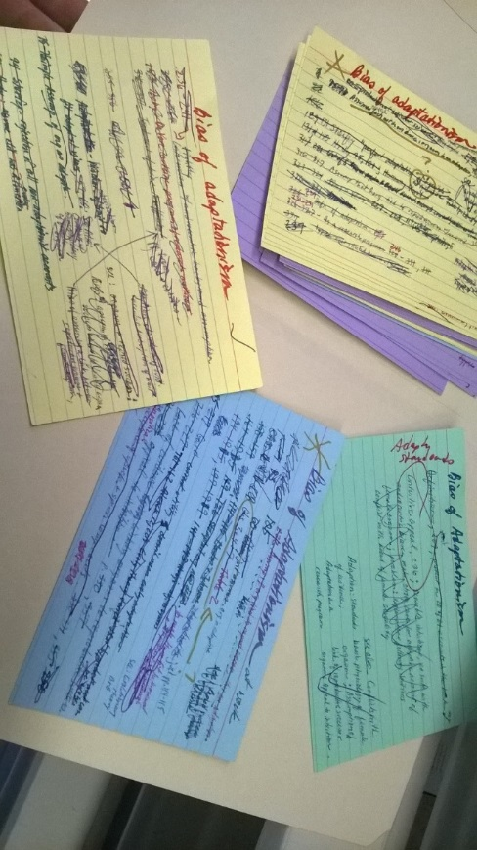
Areas of Strategic Importance Archives and Special Collections
Urban Planning
Children’s Literature
History of Books & Printing
Philosophy of Science
Theater and Performing Arts
University History
Labor Movement
Environmentalism
Political Papers and Activism
Medical Innovation

Slide 10
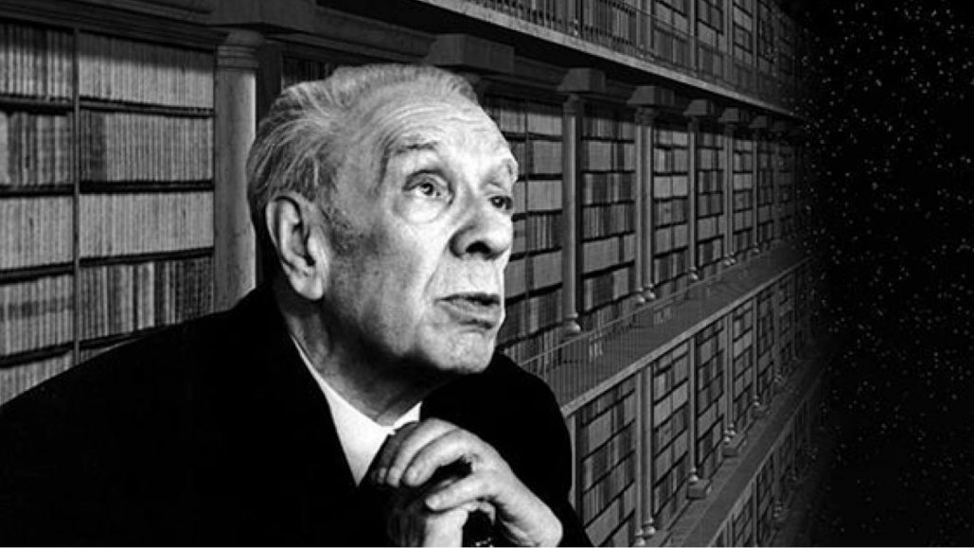
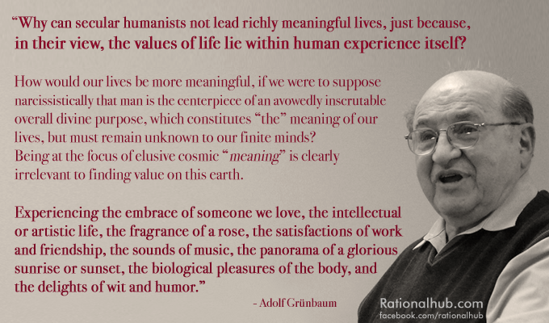
New Archival and Manuscript Collections
Borges manuscript notebook
Erma D’Ascenzio (first female on City Council)
Edward Gurjuoy (noted Pitt physicist)
Adolf Grunbaum (noted Pitt philosopher)
Nuel Belnap (noted Pitt philosopher)

Slide 11
Historic Pittsburgh
historicpittsburgh.org

Slide 12
Areas of Strategic Importance
People Expertise
Special Collections
Research Support
Digital Scholarship
Community Engagement
Open Access
OA Journal Publishing Program: http://library.pitt.edu/publications
OA repositories
D-Scholarship@Pitt http://d-scholarship.pitt.edu
Archive of European Integration http://aei.pitt.edu
philsci-archive http://philsci-archive.pitt.edu
Grants and fundraising

Slide 13
Building Updates
Hillman renovation
Thomas Blvd. high-bay storage
Langley renovation
Titusville campus

Slide 14
Thank You
Questions?

