Slide 1
Steve Wisniewski
Vice Provost for Budget & Analytics
Amanda Brodish
Director of Data Analytics & Pathways for Student Success
Web: www.pathways.pitt.edu Email: PathwaysHelp@pitt.edu

Slide 2
Outline
What is Pathways? Why Pathways?
Components of Pathways
Implementation Timeline
Questions

Slide 3
What is Pathways?
Student success initiative designed to help staff at Pitt most effectively serve students
Advising and analytics components

Slide 4
Why Pathways?
Student’s advising notes in multiple systems
No consistent way to refer students to other units
No proactive way to ID students who need support
Improve retention and graduation rates
Reduce gaps in achievement

Slide 5
Committee Structure
Steering Committee
Faculty Committee
Student Committee
Implementation Committee

Slide 6
Components of Pathways
Navigate Student: Student-facing phone app
Navigate: Advisor-facing platform
Othot Predictive Analytics platform
Recommendation Engine

Slide 7
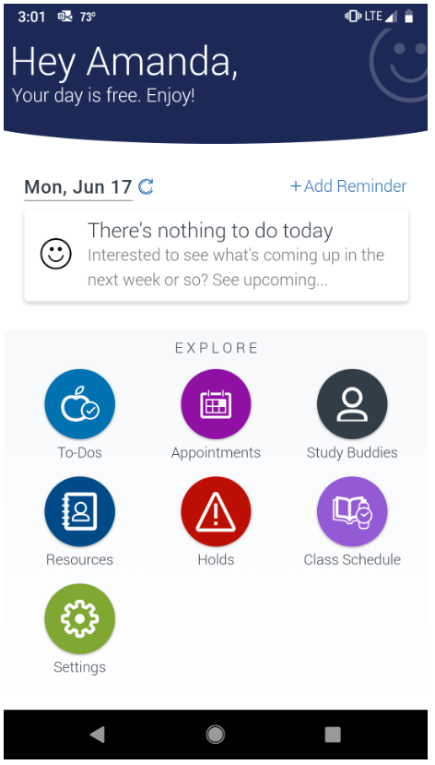
Navigate Student App
In-Take Survey
Tips/To Dos/Events
Appointment Scheduling
Study Group
Resources
Holds

Slide 8
Navigate Platform
Advisor-facing platform
Displays PS data in a user-friendly way
Used for:
Scheduling appointments
Leaving notes/summaries of advising appointments
Referring students to other offices
Messaging students

Slide 9
Navigate Platform
Key features
Direct link to student’s Academic Advising Report
Student’s picture
Watch lists
Appointment campaign
Easy tracking of appointments, cancelations, and no shows

Slide 10
Navigate Platform – Security
Pathways uses role-level security rather than row-level security in PeopleSoft
Developed job-specific roles: e.g., advisor role vs. front desk role
Approach is FERPA-compliant, but requires enhanced attention to what information should be included in an advising report or note

Slide 11
Navigate Platform – What goes in
All users must watch FERPA video
Pathways team has developed best practices on what to include in advising notes and reports

Slide 12
Navigate Platform – What goes in

Slide 13
Navigate Platform – What goes in
All users must watch FERPA video
Pathways team has developed best practices on what to include in advising notes and reports
Working group of advisors to develop Pathways-specific documentation guidelines
Upcoming workshops on documentation and referrals

Slide 14
Navigate Platform – What goes out
Used to help students based on the job responsibilities for which access was granted
Appropriate Use | Inappropriate Use
Inform an advising appointment | Decide what grade to give a student
Identify struggling students | Identify research participants
Identify groups of students eligible for awards | Satisfy your curiosity about a student

Slide 15
Othot Platform
Predictive Analytics around “High Impact Questions” (HIQs)
Retained through the current year/term
Graduate within six years
Post-graduation placement
Information shared with advisors, not students
Broadly released only after thorough vetting

Slide 16
Othot Platform
Worked with student committee to develop an opt-out process and communication plan
Working with student committee and pilot group of advisors on how to communicate results of models to students
Next HIQ will focus on student engagement

Slide 17
Recommendation Engine
Recommends Non-Academic Activities
Study Abroad
Outside the Classroom Curriculum
Recommendations not shared directly with students

Slide 18
Implementation
Where we have been
Where we are going
AY2019
AY2020
AY2021

Slide 19
AY18-19
Fall 2019
Spring 2020
Fall 2020
Spring 2021
1st year Engineering
All UG in Nursing
All UG in SCI
ASSSA
Residence Life
Tutoring in Nursing
Color Key
Primary Academic Advising Unit
Support Unit
Tutoring

Slide 20
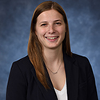
Year 1 Success Story!
“In general, the Pathways software has definitely helped me as an advisor to stay organized and document the interactions I have had with my students. After a large number of students were added to my advising case load, I was able to use the notes the previous advisor entered in Pathways to become informed about the students. Also, the software gave my students the autonomy—and the responsibility—to schedule an appointment with me when they needed me. This gave the students a chance to learn when they needed me, but also know that there was someone there to help.”
Devin Kiska, Academic Advisor in the Swanson School of Engineering

Slide 21
AY18-19
Fall 2019
Spring 2020
Fall 2020
Spring 2021
1st year Engineering
All UG in Nursing
All UG in SCI
ASSSA
Residence Life
Tutoring in Nursing
All UG in Engineering
All UG in CGS
Dietrich Advising Center
TRIO/SSS Program
Pitt EXCEL
Engineering Retention
Academic Coaching
Honors College
PIC – Health Careers
Veterans Services
Career Center
International Services
Color Key
Primary Academic Advising Unit
Support Unit
Tutoring
Pitt-Bradford Advising Center
Pitt-Bradford Bio & Health Division
Pitt-Greensburg Advising Center
Pitt-Johnstown Academic Success Center

Slide 22
Year 2 Success Story!
“When [our receptionist] was here, she spent the majority of her day on … transfers. She told me before she left that she spent anywhere from 4 – 6 hours on transfers, primarily because she was trying to contact them via phone. I experienced that for a short time before creating a campaign for Transfer students to schedule their appointments. Now, I spend about an hour each day on transfers. That’s a savings of 3 – 5 hours a day! Campaign’s work!”
- Maggie Schneider, Assistant Director, Dietrich School Advising Center

Slide 23
AY18-19
Fall 2019
Spring 2020
Fall 2020
Spring 2021
1st year Engineering
All UG in Nursing
All UG in SCI
ASSSA
Residence Life
Tutoring in Nursing
All UG in Engineering
All UG in CGS
Dietrich Advising Center
TRIO/SSS Program
Pitt EXCEL
Engineering Retention
Academic Coaching
Honors College
PIC – Health Careers
Veterans Services
Career Center
International Services
Biological Sciences
English & Film Studies
UCIS Certificate Advisors
Financial Aid Wellness Center
Study Lab Tutoring
Pitt-Bradford Tutoring
Components of Pitt-Johnstown Tutoring
Pitt-Greensburg Career Center
Color Key
Primary Academic Advising Unit
Support Unit
Tutoring
Pitt-Bradford Advising Center
Pitt-Bradford Bio & Health Division
Pitt-Greensburg Advising Center
Pitt-Johnstown Academic Success Center

Slide 24
AY18-19
Fall 2019
Spring 2020
Fall 2020
Spring 2021
1st year Engineering
All UG in Nursing
All UG in SCI
ASSSA
Residence Life
Tutoring in Nursing
All UG in Engineering
All UG in CGS
Dietrich Advising Center
TRIO/SSS Program
Pitt EXCEL
Engineering Retention
Academic Coaching
Honors College
PIC – Health Careers
Veterans Services
Career Center
International Services
Biological Sciences
English & Film Studies
UCIS Certificate Advisors
Financial Aid Wellness Center
Study Lab Tutoring
Pitt-Bradford Tutoring
Components of Pitt-Johnstown Tutoring
Pitt-Greensburg Career Center
All UG in Social Work
All UG in SHRS
All UG in Dental Med
Communications
Economics
Neuroscience
Political Science
Psychology
Study Abroad
Student Services in Pharmacy
Math Assistance Center
Pitt-Bradford Comm & Arts and Beh & Social Sci Divisions
Pitt-Greensburg key academic affairs
Pitt-Johnstown interested faculty
Pitt-Johnstown Career Center
Color Key
Primary Academic Advising Unit
Support Unit
Tutoring
Pitt-Bradford Advising Center
Pitt-Bradford Bio & Health Division
Pitt-Greensburg Advising Center
Pitt-Johnstown Academic Success Center

Slide 25
AY18-19
Fall 2019
Spring 2020
Fall 2020
Spring 2021
1st year Engineering
All UG in Nursing
All UG in SCI
ASSSA
Residence Life
Tutoring in Nursing
All UG in Engineering
All UG in CGS
Dietrich Advising Center
TRIO/SSS Program
Pitt EXCEL
Engineering Retention
Academic Coaching
Honors College
PIC – Health Careers
Veterans Services
Career Center
International Services
Biological Sciences
English & Film Studies
UCIS Certificate Advisors
Financial Aid Wellness Center
Study Lab Tutoring
Pitt-Bradford Tutoring
Components of Pitt-Johnstown Tutoring
Pitt-Greensburg Career Center
All UG in Social Work
All UG in SHRS
All UG in Dental Med
Communications
Economics
Neuroscience
Political Science
Psychology
Study Abroad
Student Services in Pharmacy
Math Assistance Center
Pitt-Bradford Comm & Arts and Beh & Social Sci Divisions
Pitt-Greensburg key academic affairs
Pitt-Johnstown interested faculty
Pitt-Johnstown Career Center
Anthropology
Chemistry
Geology & Environmental Science
History
Mathematics
Physics & Astronomy
Sociology
Statistics
AY2022
Color Key
Primary Academic Advising Unit
Support Unit
Tutoring
Pitt-Bradford Advising Center
Pitt-Bradford Bio & Health Division
Pitt-Greensburg Advising Center
Pitt-Johnstown Academic Success Center
Remaining Dietrich Departments

Slide 26
Referrals
Currently in Platform | Coming Soon…
Academic Advisor | International Services
Financial Aid | Career Center
Honors College | Study Lab
PIC Health Careers | Academic Coaching
Residence Life
Study Abroad
Veterans Services

Slide 27
Questions?
Web: www.pathways.pitt.edu Email: PathwaysHelp@pitt.edu

